Slide 1

Bike Dekho – Bike Sales Analysis Excel Project
This project provides an in-depth analysis of bike sales data using Microsoft Excel. It includes interactive dashboards, pivot tables, and visualizations to gain insights into sales performance across various categories such as regions, customer demographics, and product types.
Presented by
Madhuri Pingle

Slide 2
Project Overview
This project provides an in-depth analysis of bike sales data using Microsoft Excel. It includes interactive dashboards, pivot tables, and visualizations to gain insights into sales performance across various categories such as regions, customer demographics, and product types.

Slide 3
Project Objective
To clean and organize raw bike sales data for better usability.
To perform exploratory data analysis (EDA) using Excel formulas and PivotTables.
To uncover key patterns in customer demographics, bike preferences, and sales performance.
To create an interactive and insightful dashboard for decision-makers.

Slide 4
Key Steps in the Project
Data Cleaning: Identify and remove duplicates, standardize categorical data (e.g., marital status, gender).
Create Working Sheet: Copy raw data to a working sheet for manipulation, keeping the original data intact.
Pivot Tables: Utilize pivot tables to summarize and analyze data for visualization.
Visualizations: Build visualizations using recommended charts to represent key insights, such as average income, commute distance, and age brackets.
Dashboard Creation: Copy visualizations onto a dashboard sheet for a consolidated view.
Chart Customization: Adjust chart titles, axis labels, and formatting for better clarity.

Slide 5
Pivot Tables and Visualization
Bike Purchase by gender and region with Customer count: Displays the bike purchases by gender and region of customers who bought bikes. Visualized with a bar chart.
Purchase bike by customer demographics: Shows the count of bike purchases by customer demographics.
Impact of income and occupation on bike purchasing behavior: Displays the sales comparison by income and occupation. It’s shows the impact of income and occupation on bile purchasing behavior.
Customer Commute and Bike Purchases: Shows the count of bikes purchased, with commute distance on the X-axis and the number of purchases on the Y-axis. Visualized with a line chart.
Bike Purchases by Age Brackets: Categorizes customers into three age brackets (Adolescent, Middle Age, Old) and displays the count of bikes purchased in each bracket. Visualized with a line chart.
Slicers and filters: Applied slicers and filters on Marital status, Home owner, Education and Children. Its help to analyze the bike sales data insightfully.

Slide 6
Key Matrix (KPIs)
KPI Value
Total Unit Sold 482
Customer Average Income $57925.31
Customer Count 1000

Slide 7
Dashboard
The dashboard includes:
A column chart showing purchase trend by gender and region.
A line chart showing customer commute with the count of purchased bikes.
A line chart showing the count of purchased bikes by age brackets.
A bar chart show impact bike purchases by income and occupation on purchasing behavior.
Additionally, slicers for marital status, home owner, children and education were added to enable interactive data filtering.

Slide 8
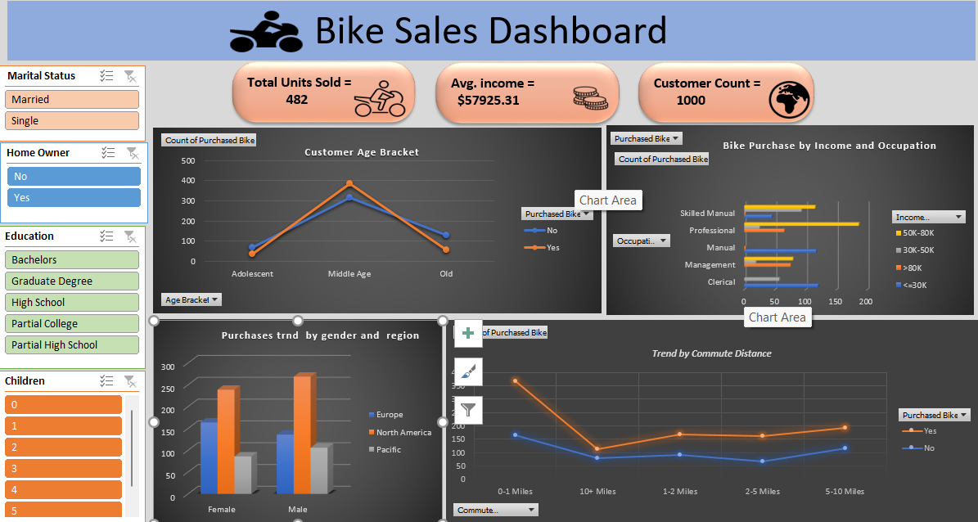

Slide 9
Business Insights
Married males aged 30–45 with income between 50K to 80K are the most frequent bike buyers.
Professional males with income between 50K to 80K have purchased the most bikes.
North America recorded the highest purchase volume.
Customer income and occupation significantly influence purchasing behavior.
Customers in the middle age bracket are the most frequent buyers.

Slide 10
Conclusion
This project provides insights into bike buyers' purchasing behavior, emphasizing the influence of factors like gender, age, and commute distance. The dynamic dashboard enhances user interaction, making data exploration more intuitive and informative.

